Slide 1
IC Engines 2nd part
Ramu Rajendran

Slide 2
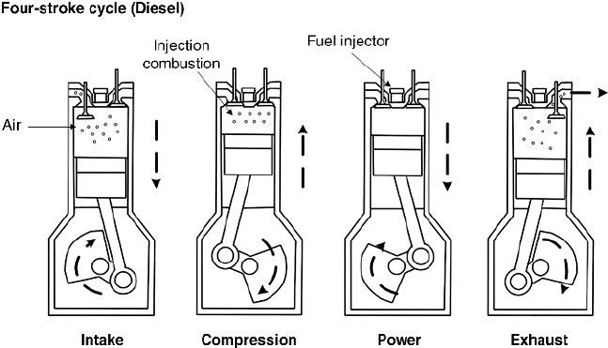

Slide 3
Primary Difference with Petrol Engine
No Spark Plug. Instead fuel injector is used.
This is CI engine. Petrol engine is SI engine.
During suction stroke air comes in. For petrol engines air-fuel mixture comes in.
Compression ratio is high compared to petrol engines.
It uses Diesel Cycle, whereas petrol engines uses Otto Cycle.

Slide 4
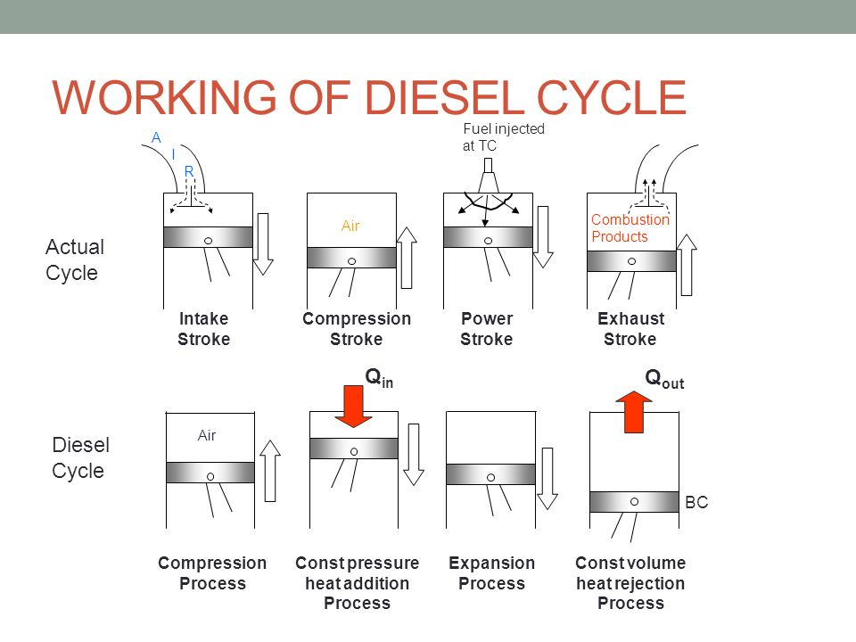

Slide 5
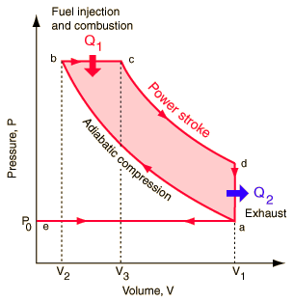
Diesel Cycle

Slide 6
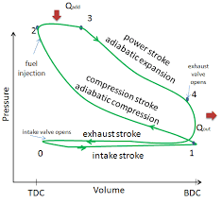
ACTUAL CYCLE

